Slide 1

Basic Details of the Team and Problem Statement
Computer Science and Engineering Department
Minor Project Synopsis 2022
Project Team ID: CSE1-57
Problem Statement Title: ANALYZING AND RATING GREENNESS OF NATURE-INSPIRED ALGORITHMS
Guide Name: Ms. SHALLU JUNEJA
Theme of Project: Green Computing, Big Data, and Analysis
Co-Guide Name: Dr. DEEPAK GUPTA
Team Name: ByteCoders
Team Member 1: Kanaishk Garg
07714802719
7C4
Team Member 2: Chander Jindal
06514802719
7C4
Team Member 3: Shobhit Kumar
07614802719
7C4

Slide 2
Idea Details
Nature-inspired algorithms have become prevalent to address a variety of optimization problems in real-world applications because of their simplicity, flexibility, and effectiveness.
This study intends to provide a critical analysis of energy consumption and their corresponding carbon footprint for some popular NIO algorithms like Bat Algorithm, Camel Algorithm, Particle Swarm Optimization etc.
Microsoft Joulemeter will be employed for measuring the energy consumption during the runtime of each algorithm, while corresponding carbon footprint of each algorithm is calculated based on the Central Electricity Authority of India’s guide
Tech Stack:
Python
Sklearn
NiaPy
Pandas
Jupyter-Notebook

Slide 3
Expected Outcome
Use Cases
Dependencies / Show-stopper
This study will help guide software engineers and practitioners in their selection of an energy-efficient NIO algorithm
In future if developers want to switch to some other models they only need to compare energy efficiency of the new model with the most efficient one pointed out by this study thus saving time.
Sklearn Nature Inspired Algorithm
NiaPy
Sklearn Random Forest Classifier
Bayesian Optimization (bayes_opt)
Microsoft Joulemeter

Slide 4
Approach Details
Nature-inspired algorithms are a set of novel problem-solving methodologies and approaches derived from natural processes. Some of the popular examples of nature-inspired optimization algorithms include: genetic algorithm, cuckoo search algorithm and so on. These algorithms are highly efficient in finding optimized solutions to multi-dimensional and multi-modal problems. But traditionally efficiency has only been measured in terms of runtime and not energy consumed during runtime.
Due to the proliferation of mobile and IoT devices, software energy consumption should be taken into account during the design of applications for high-performance and mobile computing systems. Software applications could be made more energy-efficient and environment-friendly by means of their optimized algorithms and data structures. Now among these algorithm which will be most efficient energy wise for solving the given problem is a area of study which we intend to explore.

Slide 5
Objectives
Conduct a critical literature review on the environmental impact of ICT, green or energy-efficient software, the impact of hardware energy consumption by software, and the analysis of energy consumption in algorithms implementations as well as nature-inspired algorithms and energy efficiency.
Implement the above-stated NIO Algorithms using Python programming language and the class NatureInspiredSearchCV provided by the sklearn_nature_inspired_algorithms library and NiaPy for nature inspired algorithms, a series of experiments to determine how much energy each method consumes is carried out by Bayesian Optimization.
Estimate the equivalent carbon footprint of each algorithm based on the amount of energy consumed by each algorithm.

Slide 6
Results
Name of the Algorithm | Keys | Avg Accuracy | Avg Time Taken (s) | Avg Energy Used (J) | Avg Equivalent CO2 Emission (mg)
Bat Algorithm | ['BAT-0042', 'BAT-0034', 'BAT-0008', 'BAT-0029', 'BAT-0011', 'BAT-0017', 'BAT-0003', 'BAT-0040', 'BAT-0016', 'BAT-0020'] | 93.13047 | 239.0 | 792.46 | 187.1086
Camel Algorithm | ['CAM-0000', 'CAM-0049', 'CAM-0024', 'CAM-0003', 'CAM-0026', 'CAM-0008', 'CAM-0041', 'CAM-0033', 'CAM-0025', 'CAM-0006'] | 93.12125 | 242.5 | 779.44 | 184.0344
Cuckoo Search Algorithm | ['CUC-0009', 'CUC-0031', 'CUC-0010', 'CUC-0042', 'CUC-0035', 'CUC-0040', 'CUC-0041', 'CUC-0039', 'CUC-0046', 'CUC-0048'] | 93.07515 | 216.8 | 700.11 | 165.3037
Firefly Algorithm | ['FIR-0042', 'FIR-0037', 'FIR-0003', 'FIR-0049', 'FIR-0043', 'FIR-0041', 'FIR-0014', 'FIR-0009', 'FIR-0012', 'FIR-0000'] | 93.14431 | 261.1 | 827.82 | 195.4575
Particle Swarm Algorithm | ['PAR-0016', 'PAR-0043', 'PAR-0030', 'PAR-0003', 'PAR-0022', 'PAR-0004', 'PAR-0045', 'PAR-0044', 'PAR-0032', 'PAR-0015'] | 93.12125 | 96.4 | 317.35 | 74.9299

Slide 7
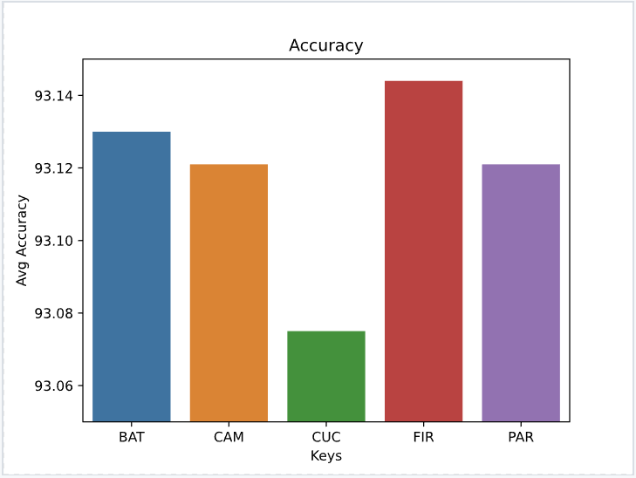
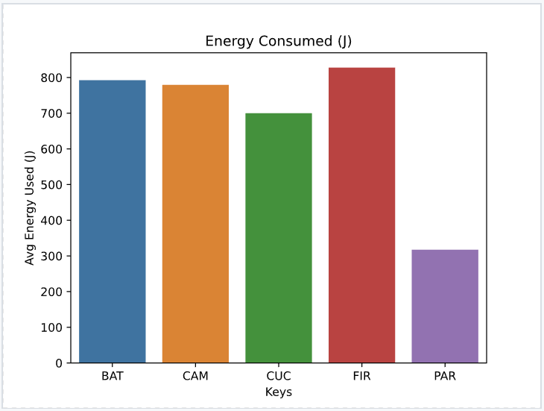
Average Accuracy of Top 10 models of each algorithm
Average Energy Consumed by Top 10 models of each algorithm

Slide 8
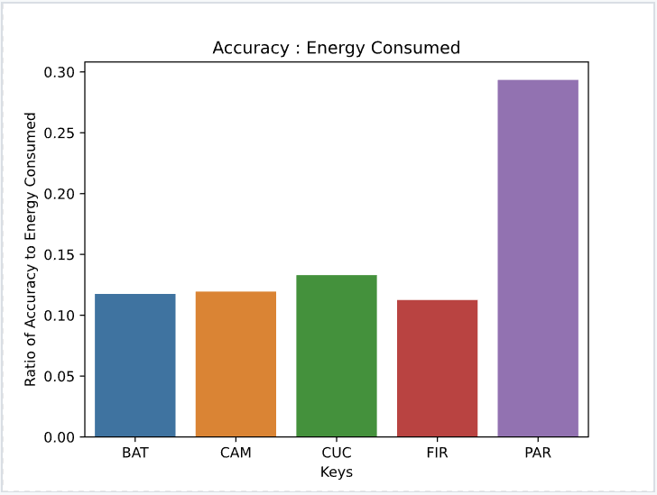
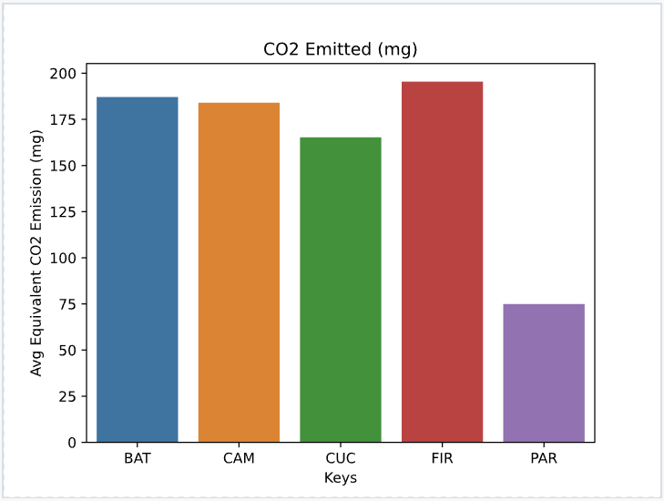
Accuracy to Energy Consumed of Top 10 models of each algorithm
Average equivalent CO2 Emissions by Top 10 models of each algorithm

Slide 9
References
[1] Jamil, M., Kor, AL. Analyzing energy consumption of nature-inspired optimization algorithms. GRN TECH RES SUSTAIN 2, 1 (2022). https://doi.org/10.1007/s44173-021-00001-9
[2] Wang, Z.; Qin, C.; Wan, B.; Song, W.W. A Comparative Study of Common Nature-Inspired Algorithms for Continuous Function Optimization. Entropy 2021, 23, 874. https://doi.org/10.3390/e23070874
[3] Johnson, B. A., & Iizuka, K. (2016). Integrating OpenStreetMap crowdsourced data and Landsat timeseries imagery for rapid land use/land cover (LULC) mapping: Case study of the Laguna de Bay area of the Philippines. Applied Geography, 67, 140-149. https://doi.org/10.1016/j.apgeog.2015.12.006.
[4] Li, H., Liu, X., Huang, Z., Zeng, C., Zou, P., Chu, Z. and Yi, J., 2020. Newly emerging nature-inspired optimization-algorithm review, unified framework, evaluation, and behavioural parameter optimization. IEEE Access, 8, pp.72620-72649.https://ieeexplore.ieee.org/abstract/document/9064786/

